Slide 1
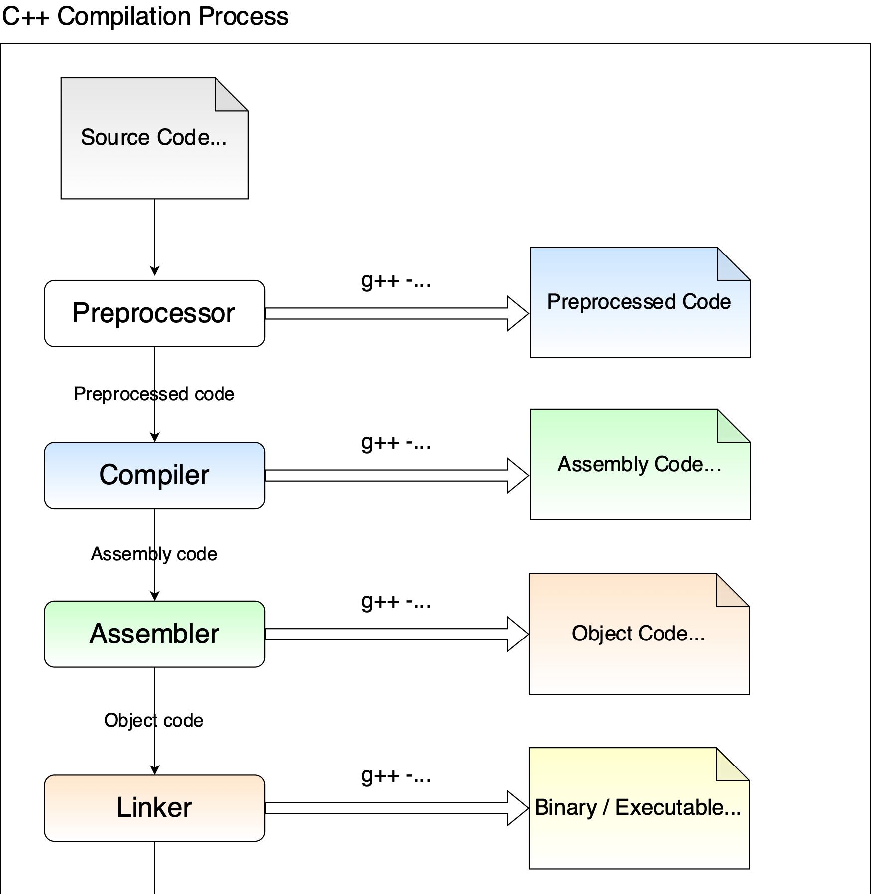

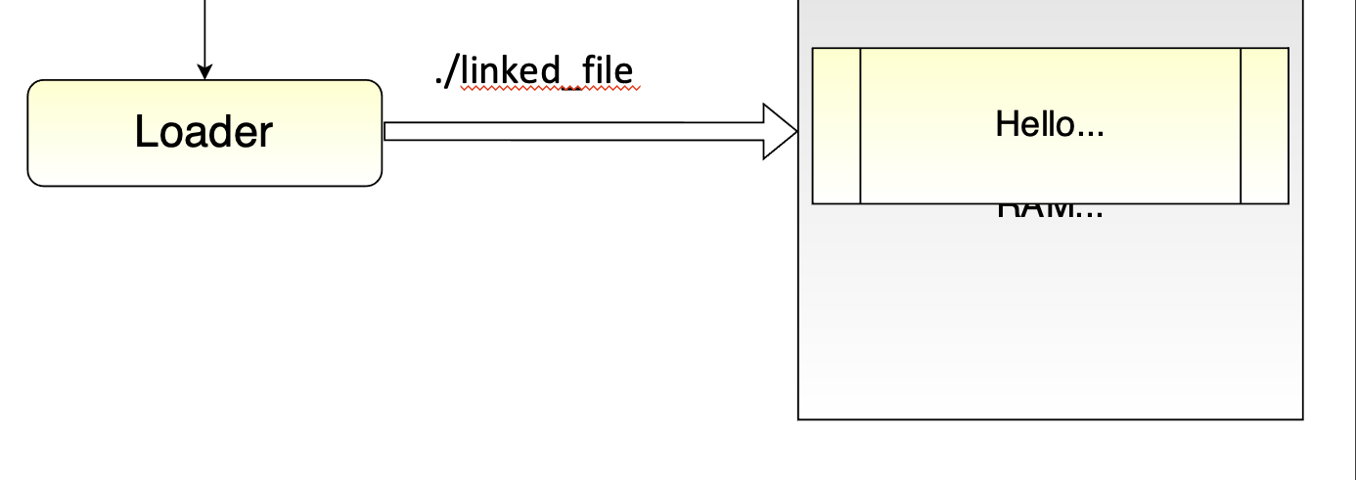
Hello.c Hello.cpp
Hello.h
Header files
gcc hello.c –E –o hello.i
gcc hello.i –S –o hello.s
Relocation object code information
Other objects files/modules
gcc hello.s –c –o hello.o
Library files
gcc hello.o stdheader.o –S –o linked_file
Stored in secondary storeage such as hard disks (hdd) as an executable image

